Slide 1
Brain Anatomy (Part III)
29 June 2017

Slide 2
Meninges (Greek ‘membrane’)
Meninges and CSF serve to stabilize the brain and provide buoyancy.
The brain actually weighs ~3 lbs. However, stabilized by the meninges and ‘floating’ in CSF, the brain effectively weighs ~0.10lb.

Slide 3
Meninges (proceeding from inner surface of skull to cortex)
Dura mater (‘tough/hard mother’)
Thick, strong, consists of layers of tightly packed collagen fibers.
Adheres to the cranial cavity.
Arachnoid mater
Wispy connective tissue, made up of layers of cells and collagen bundles (fascicles).
Arachnoid trabeculae (‘little rods’) – collagen tissue that extends and blends into pia mater.
Pia mater (‘devoted/loving mother’)
Very thin, conforms tightly to the cortex.

Slide 4
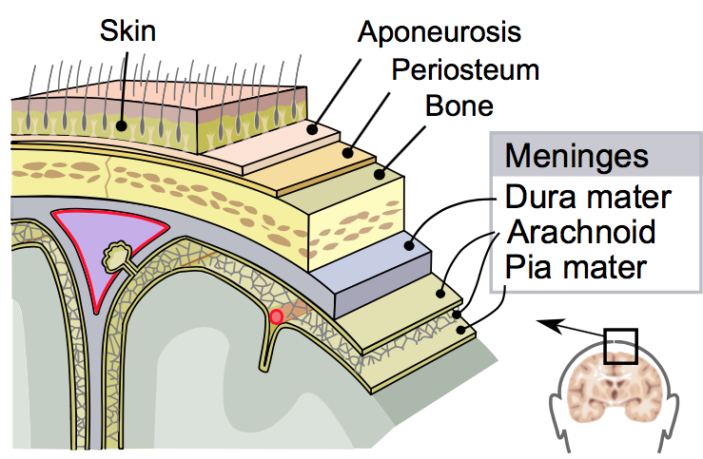
Meninges
CSF present between arachnoid and pia
Of the meninges, only dura has sensory innervation (and thus abnormalities that affect dura can cause head pain).
Notes:
By SVG by Mysid, original by SEER Development Team [1] - Vectorized in Inkscape by Mysid, based on work by SEER Development Team, Public Domain, https://commons.wikimedia.org/w/index.php?curid=10485059

Slide 5
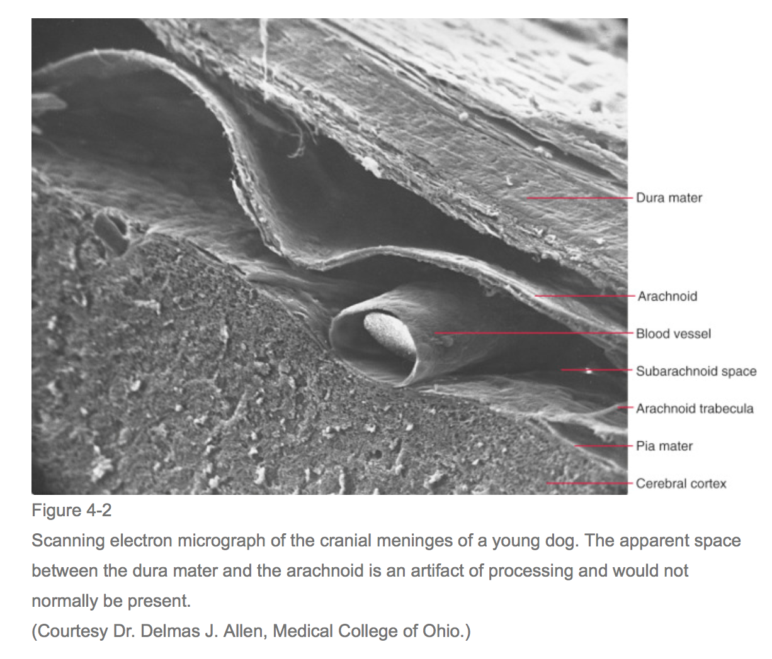
Dura, Arachnoid, and Pia
Notes:
Figure from: Mancall, E. L., & Brock, D. G. (2011). Gray's Clinical Neuroanatomy: The Anatomic Basis for Clinical Neuroscience. [E-Book]. Chicago: Elsevier Health Sciences.

Slide 6
Dural Folds
Places where inner dural layer folds into the cranial cavity
2 important dural folds
Falx cerebri: invests the longitudinal fissure (which divides two hemispheres.
Tentorium cerebelli: separates cerebrum from cerebellum.

